Slide 1
Political Campaign Database
Jeffrey Chan, Dominic Liu, Richa Mohan, Brad Wyatt

Slide 2
Agenda
Project Background
ER Diagram
Relational Schema
Further Clarifications
Queries And Their Uses
Addressing Questions On Queries
Q/A

Slide 3
Background
Hypothetical political campaign
Candidates and his/her workers as end users
Improved efficiency to eliminate redundancies and save time and money
2

Slide 4
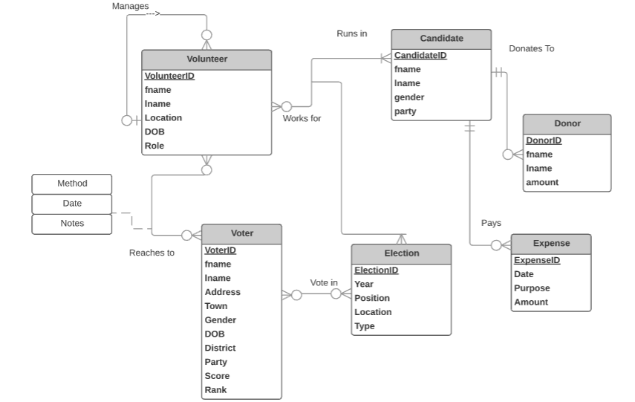
ER Diagram
3

Slide 5
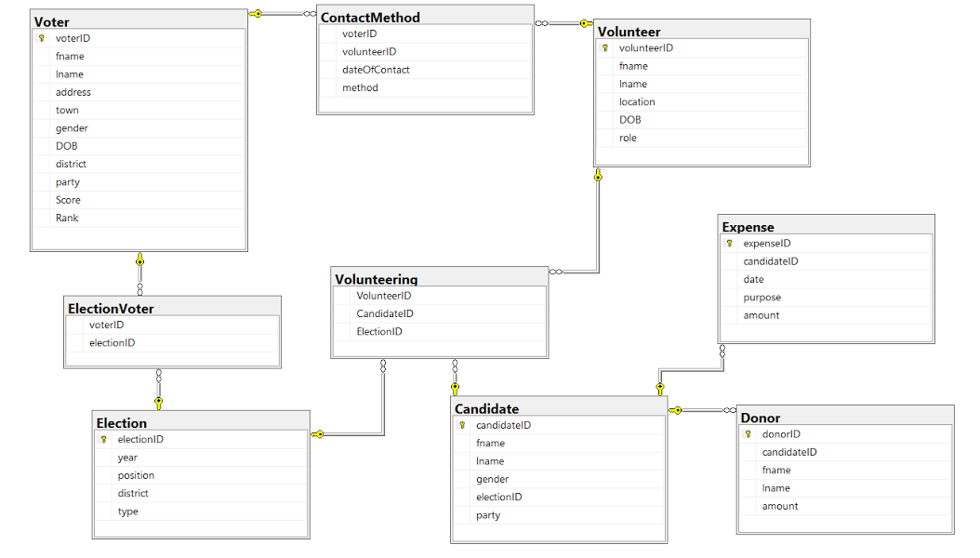
Relational Schema
4

Slide 6
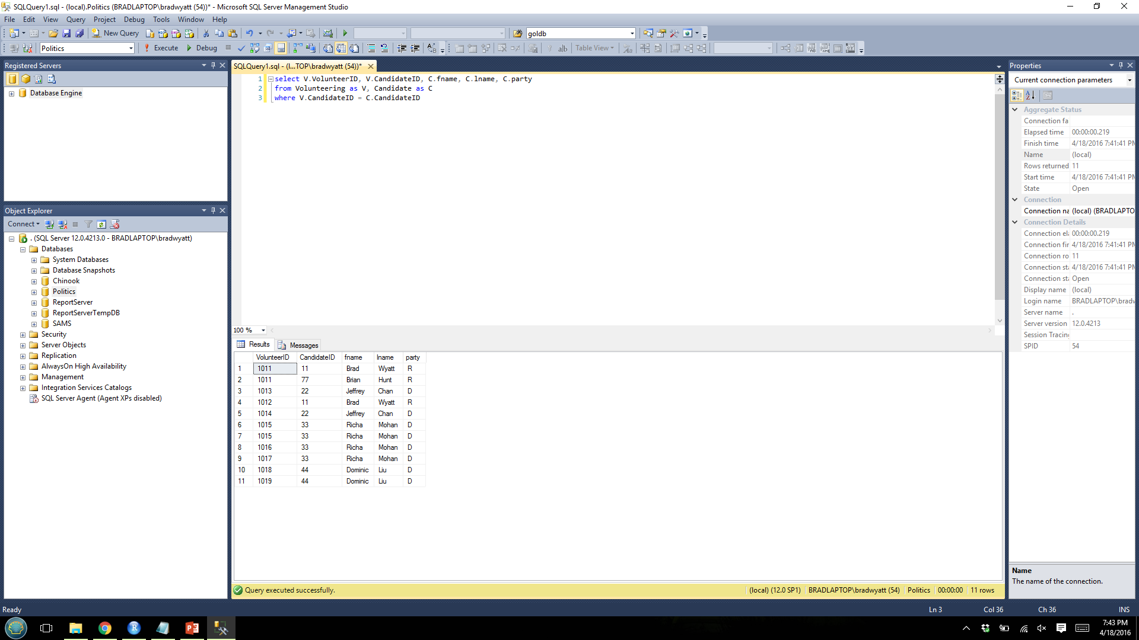
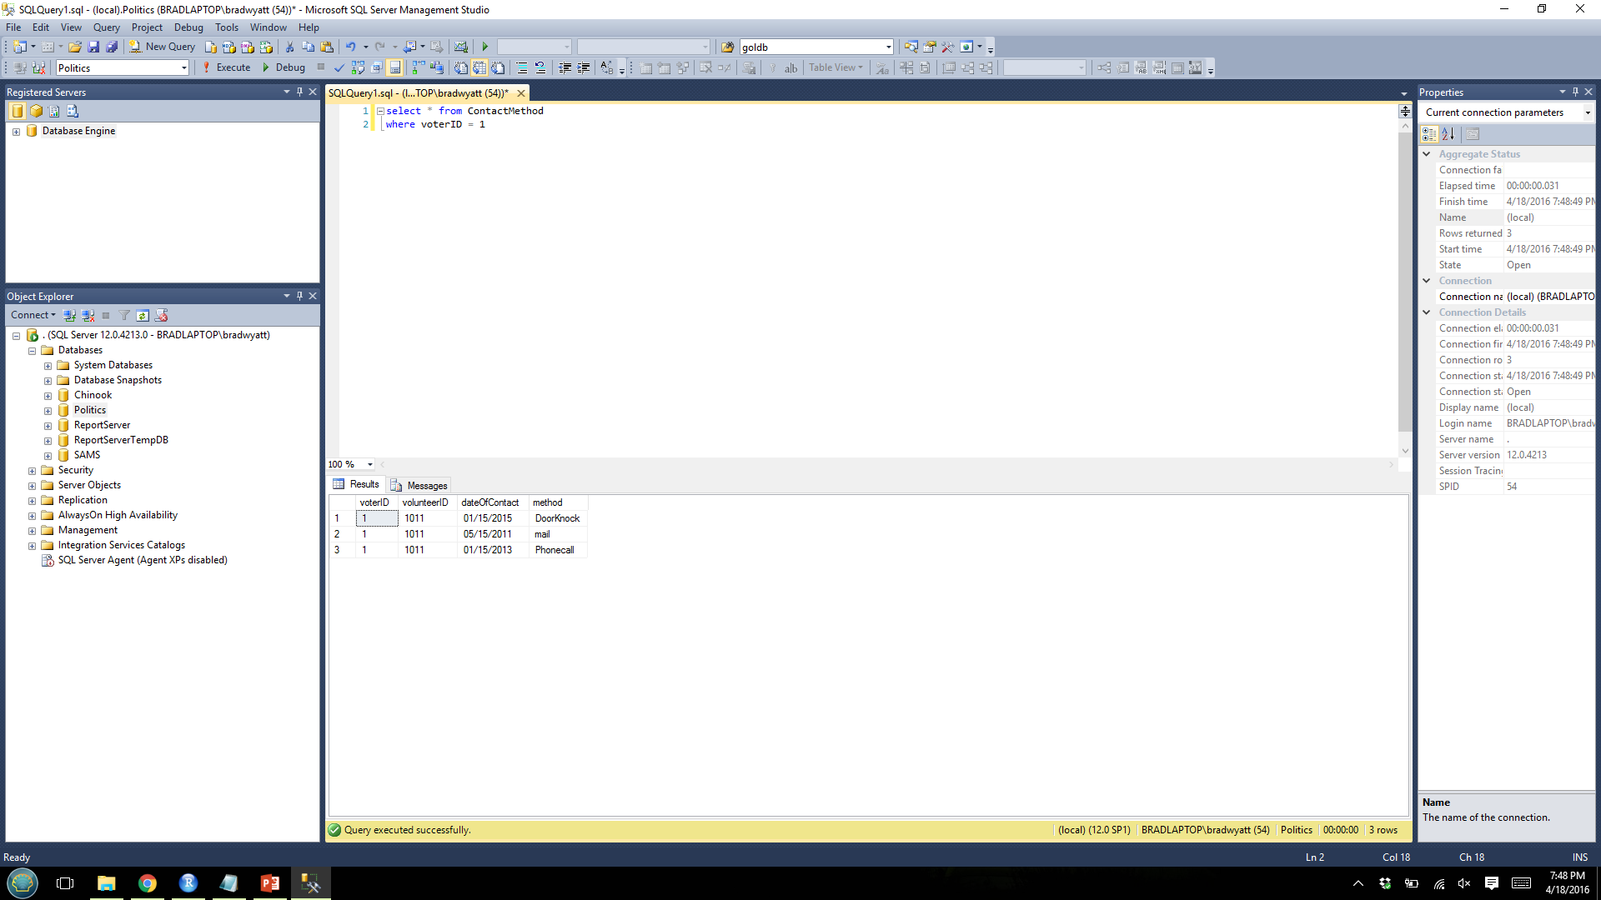
Further Clarifications
Tracking volunteers for both parties
Tracking who has voted in primaries of the opposing party
The same volunteer contacting the same voter with different methods
Meaning of Score and Rank
Score | Description
A | Always Votes
B | Sometimes Votes
C | Never Votes
Rank | Description
1 | Strong Republican
2 | Lean Republican
3 | Neutral
4 | Lean Democrat
5 | Strong Democrat
5

Slide 7
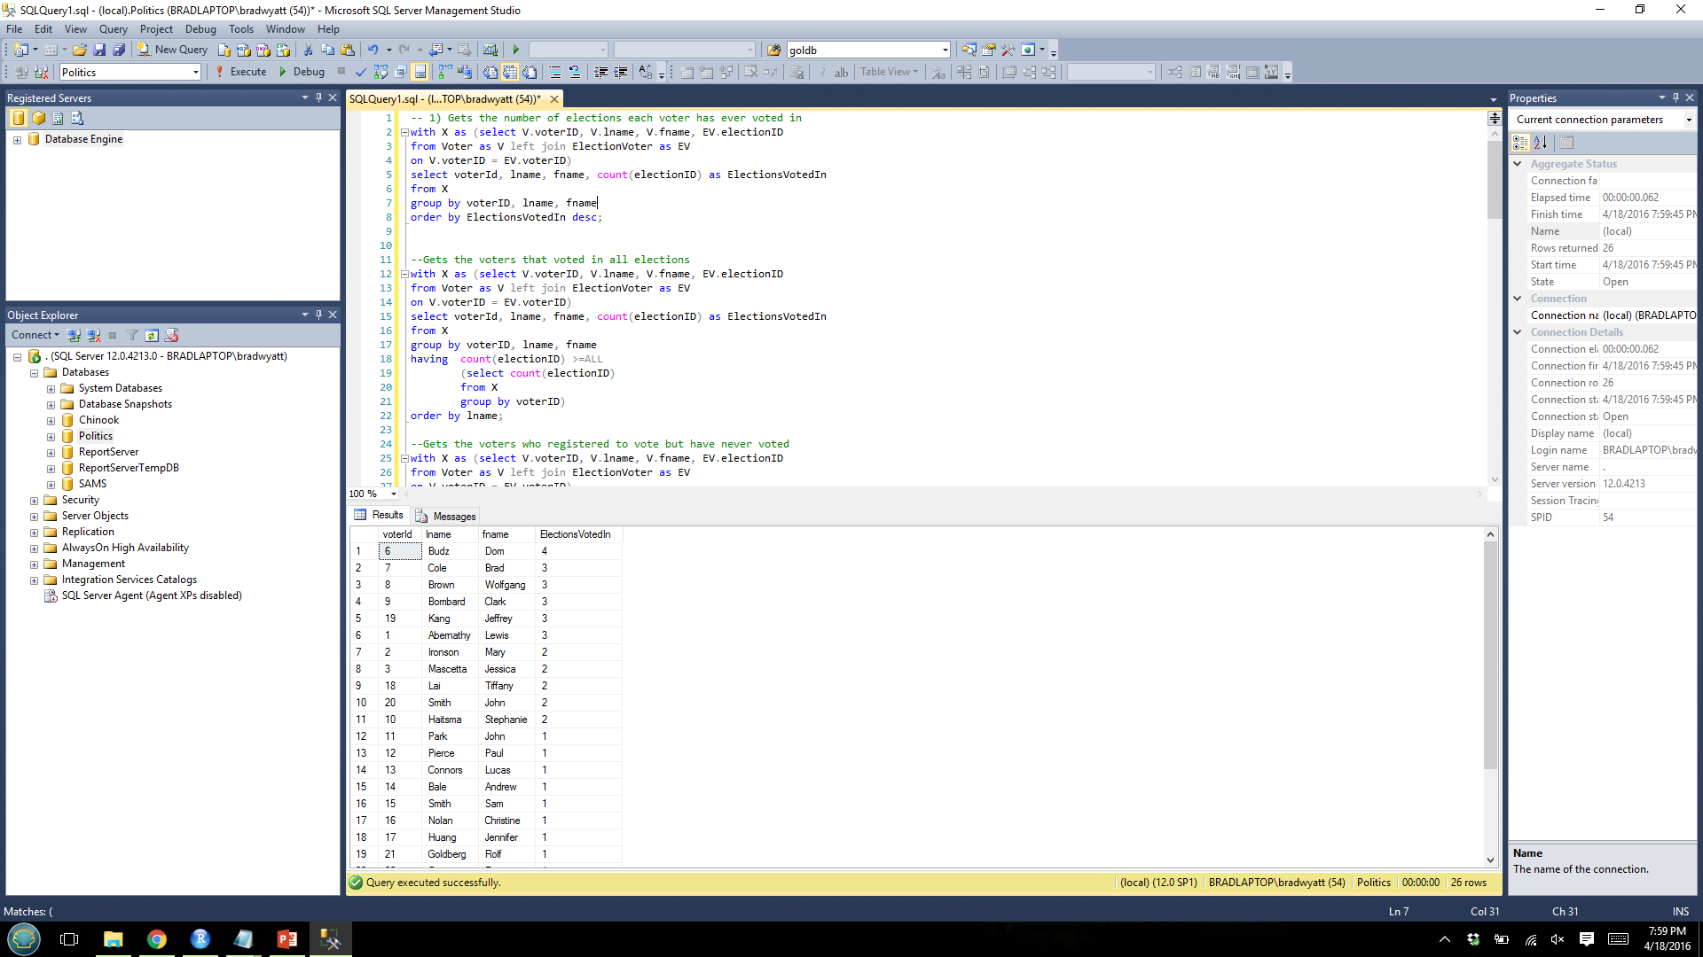
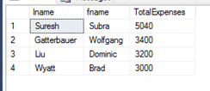
Queries and Their Uses
How consistently registered voters in the district actually vote. Candidates need to decide which voters should be targeted.
The candidates with the above average expenditure. It is common to hear that candidates that spend the most money are more likely to win elections, and it shows how committed they are to the campaign.
Less likely to vote
Serious Contenders
6

Slide 8
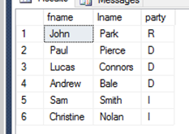
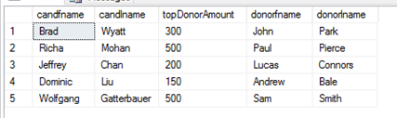

Queries and Their Uses
Political campaigns need to effectively target others, but they also need to target donors in order to make the most money.
List of candidates’ parties that each donor donated to
Top donors for each candidate
We need to identify the volunteers who volunteered for multiple elections. This means they could be more likely to volunteer on our campaign.
Volunteers who volunteered in multiple elections
7

Slide 9

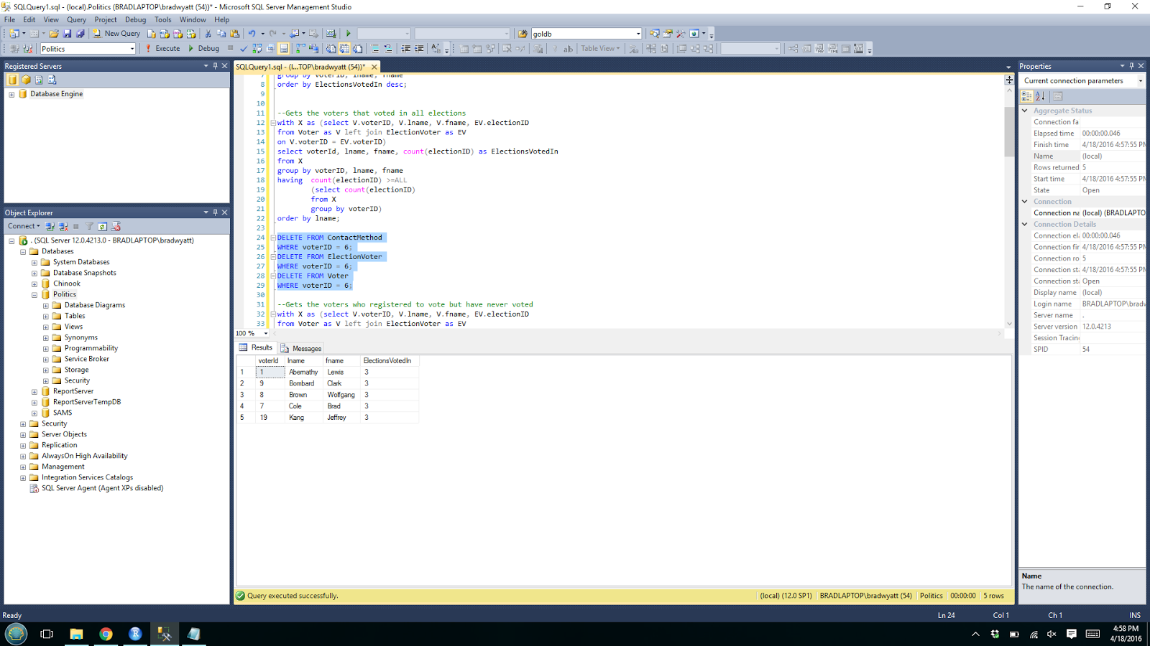
Addressing Questions on Queries
AIM: Find the Voters who voted in the maximum number of elections.
Query:
with X as (select V.voterID, V.lname, V.fname, EV.electionID
from Voter as V left join ElectionVoter as EV
on V.voterID = EV.voterID)
select voterId, lname, fname, count(electionID) as ElectionsVotedIn
from X
group by voterID, lname, fname
having count(electionID) >=ALL
(select count(electionID)
from X
group by voterID)
order by lname;
Original Result
Result after removing most consistent Voter
Q. What would happen if we removed the voter who has voted in the maximum number of elections?
A. We would get the voters who voted for the next maximum number of elections, 3 in this case.
8

Slide 10
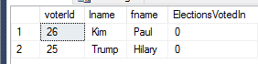
Addressing Questions on Queries
AIM: Find the Voters who “never” voted in an election
Query:
with X as (select V.voterID, V.lname, V.fname, EV.electionID
from Voter as V left join ElectionVoter as EV
on V.voterID = EV.voterID)
select voterId, lname, fname, count(electionID) as ElectionsVotedIn
from X
group by voterID, lname, fname
having count(electionID) <=ALL
(select count(electionID)
from X
group by voterID)
order by lname
Original Result
Q. Does this really return the voter who “never voted”?
A. No, it returns the voter/s who voted in the least number of elections.
9

Slide 11
Addressing Questions on Queries
AIM: Finding volunteers who volunteered at multiple elections.
Original Query:
WITH alias as (SELECT V.volunteerID, V.fname, V.lname, Volunteering.ElectionID
FROM Volunteer as V, Volunteering
WHERE V.volunteerID = Volunteering.VolunteerID
GROUP BY V.volunteerID, V.fname, V.lname, Volunteering.ElectionID)
SELECT alias.volunteerID, alias.fname, alias.lname, count(alias.ElectionID) as MultElections
FROM alias
GROUP BY alias.volunteerID, alias.fname, alias.lname
HAVING count(alias.ElectionID) > 1;
WITH alias as (select Volunteering.volunteerID, Volunteering.ElectionID, V.lname, V.fname
from volunteering left join volunteer as V
on Volunteering.VolunteerID = V.VolunteerID)
Efficient substitute
Q. What if we removed Volunteering.ElectionID from the group by clause?
A. We will get an error because we are selecting it, but not performing a function over it or grouping by it.
10

Slide 12
Questions?
11

